Slide 1
Randomized Quick Sort

Slide 2
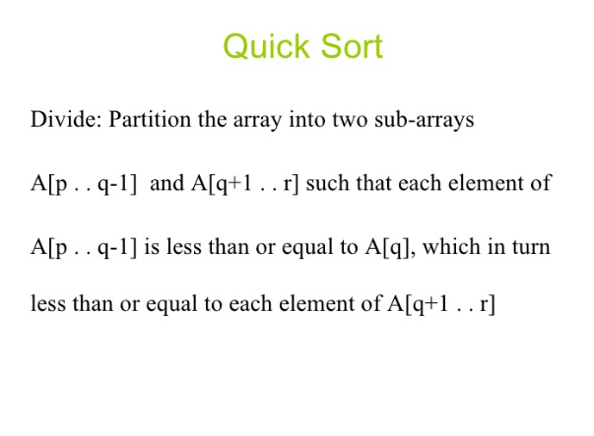

Slide 3
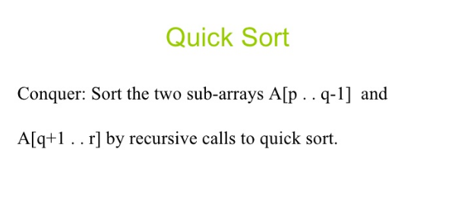
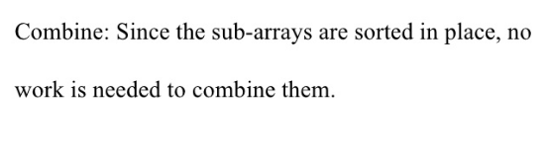

Slide 4
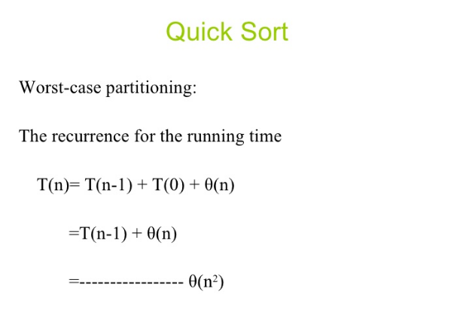


Slide 5

In the randomized version of Quick sort we impose a distribution on input by picking the pivot element randomly.
Randomized Quick Sort works well even when the array is sorted/reversely sorted and the complexity is more towards O(n log n).
(Yet, there is still a possibility that the randomly picked element is always an extreme.)

Slide 6
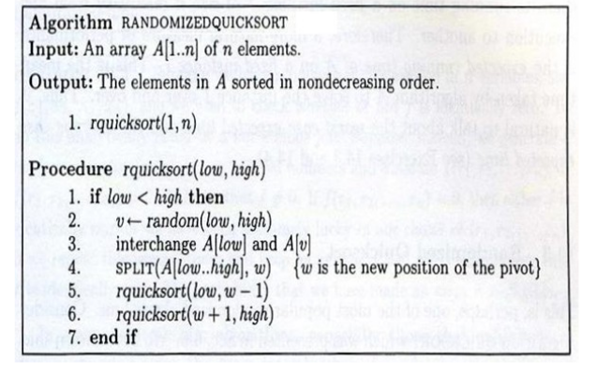

Slide 7


If the pivot is selected uniformly at random, the expected number of comparisons of this randomized version of Quicksort is bounded by O(n log n).
To analyze the total number of comparisons let us take the total number of comparisons as a sum of simpler random variables, and then just analyze the simpler ones.

Slide 8

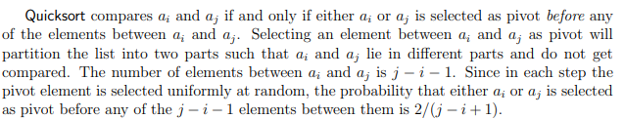
In other words, for a given element i, it is compared to element i+ 1 with probability 1, to element i + 2 with probability 2/3, to element i + 3 with probability 2/4, to element i + 4 with probability 2/5 and so on

Slide 9
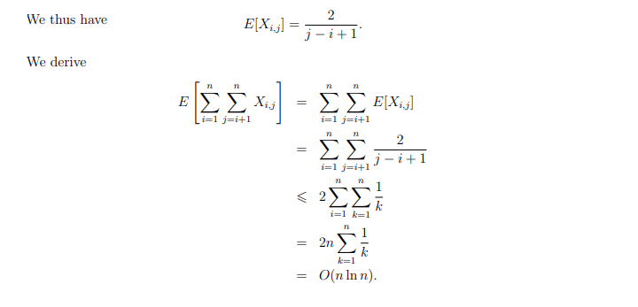

Slide 10

LINEARITY OF EXPECTATION basically says that the expected value of a sum of random variables is equal to the sum of the individual expectations.

Slide 11
STRING MATCHING ALGORITHMS
The fundamental string searching (matching) problem is defined as follows: given two strings – a text and a pattern, determine whether the pattern appears in the text.
The “Naive” Method Its idea is straightforward — for every position in the text, consider it a starting position of the pattern and see if you get a match.
The “naive” approach is easy to understand and implement but it can be too slow in some cases. If the length of the text is n and the length of the pattern m, in the worst case it may take as much as (n * m) iterations to complete the task.

Slide 12
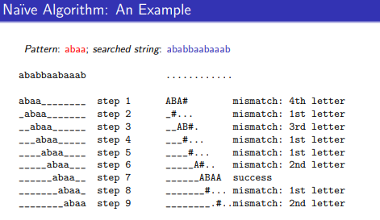

Slide 13
Rabin-Karp algorithm
Rabin-Karp algorithm is an algorithm used for searching/matching patterns in the text using a hash function.
Unlike Naive string matching algorithm, it does not travel through every character in the initial phase rather it filters the characters that do not match and then performs the comparison
A hash function is a tool to map a larger input value to a smaller output value. This output value is called the hash value.

Slide 14
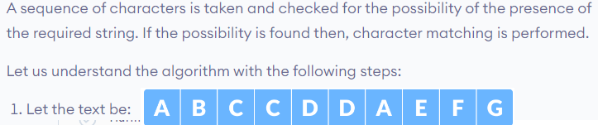
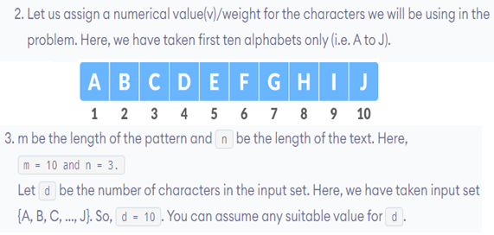
How Rabin-Karp Algorithm Works?

Slide 15
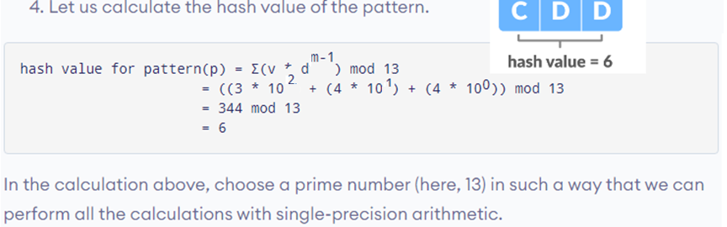
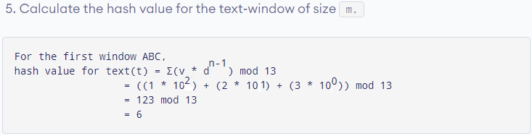

Slide 16
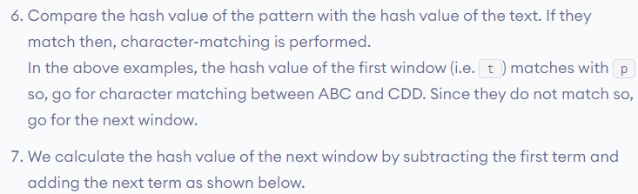


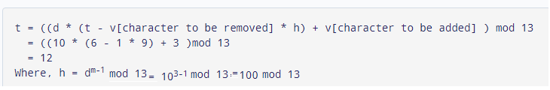

Slide 17
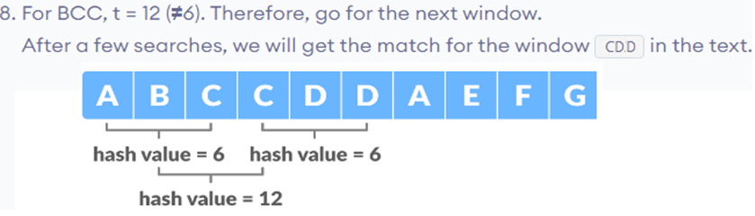
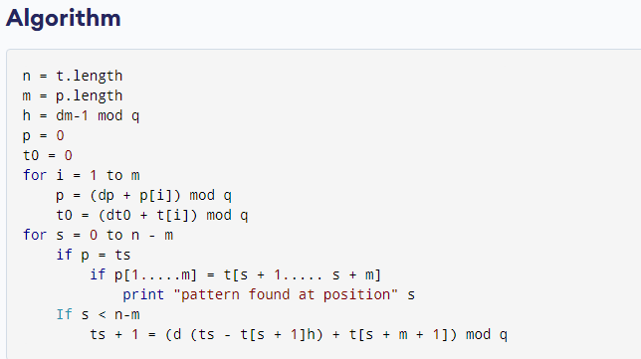

Slide 18
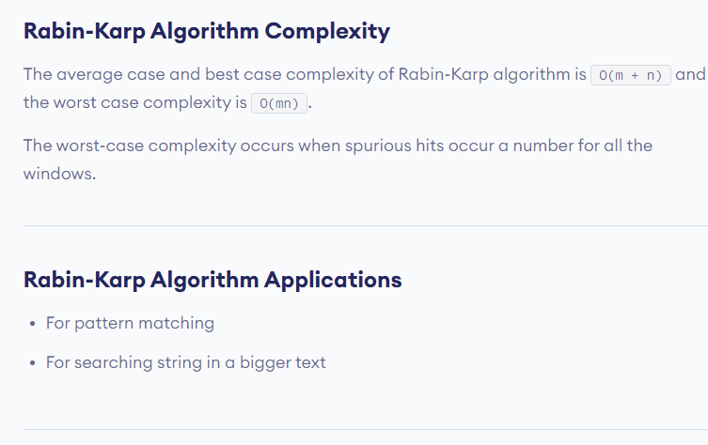

Slide 19
Other Algorithms:
Knuth-Morris-Pratt (over binary alphabet) KMP algorithm.
Use knowledge of how search pattern repeats itself.
Build DFA from pattern.
Run DFA on text.
Boyer-Moore Boyer-Moore algorithm (1974). Right-to-left scanning.
– find offset i in text by moving left to right.
– compare pattern to text by moving right to left.

Slide 20
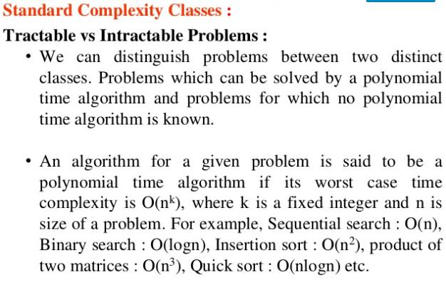

Slide 21
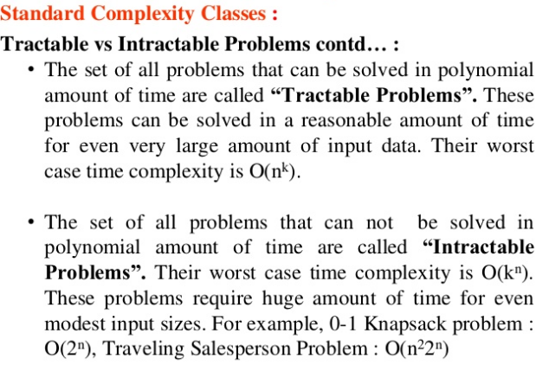

Slide 22
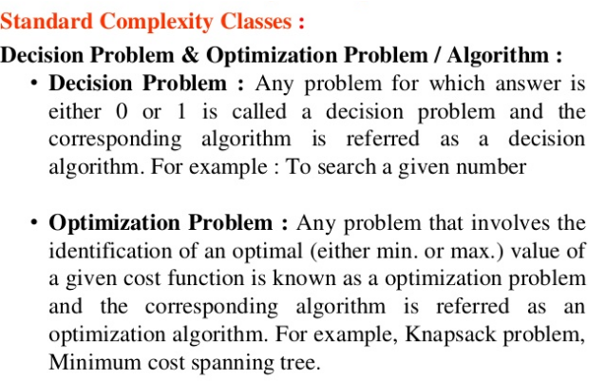

Slide 23
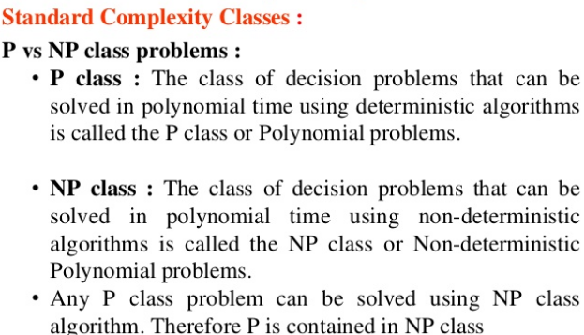
( P ⊆ NP )

Slide 24
There are a lot of problems in NP that we do not know how to solve in polynomial time. Why?
Because they really don't have polynomial algorithms? Or,
because we are not yet clever enough to have found a polynomial algorithm for them?
CONCLUSION:
All problems in NP are decidable.
That means there is an algorithm.
And, the algorithm is no worse than O(2^n).

Slide 25
At the moment, no one knows.
Some believe all problems in NP have polynomial algorithms. Many do not (believe that).
The fundamental question in theoretical computer science is:
Does P = NP?
There is an award of one million dollars for a proof.
– Either way, True or False.

Slide 26
The "Key" to Complexity Theory
'Reductions,'
"Problem A reduces to problem B" or, simply, "A  B"
Theorem. If A  B and problem B is polynomial, then problem A is polynomial.
Corollary. If A  B and problem A is exponential, then
problem B is exponential.
A  B means:
'Problem A is no harder than problem B,'
and, equivalently,
'Problem B is as hard as problem A.’

Slide 27
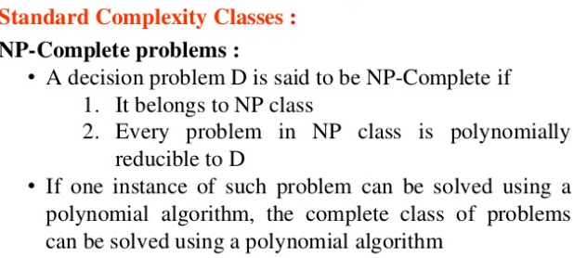

Slide 28
Polynomial Transformations enforce an equivalence relationship on all decision problems, particularly, those in the Class NP. Class P is one of those classes and is considered to be the "easiest" class of problems in NP.
Is there a class in NP that is the "hardest" class in NP?
That is, a problem B in NP such that
A _{P} B – for every A in NP.
In 1971, Stephen Cook proved there was. Specifically, a problem called
Satisfiability(or, SAT).

Slide 29
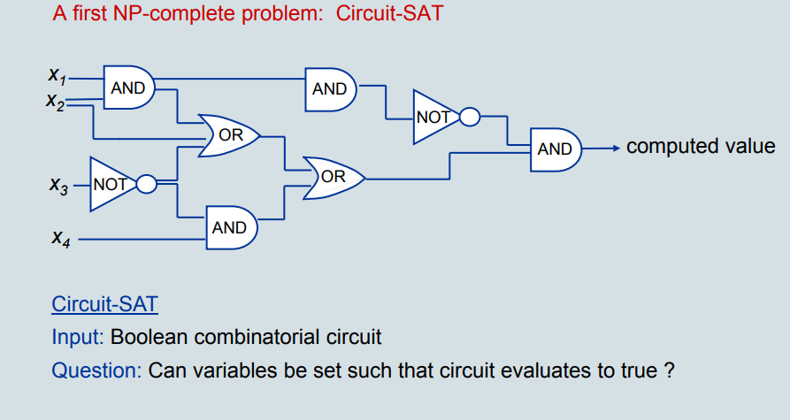
Can we assign Boolean values to the variables in U so that every clause is TRUE?
There is no known polynomial algorithm!!

Slide 30
Cooks Theorem:
1) SAT is in NP
2) For every problem A in NP,
A _{P} SAT
Thus, SAT is as hard as every problem inNP.
Since SAT is itself in NP, that means SAT is a hardest problem in NP (there can be more than one).
A hardest problem in a class is called the "completion" of that class.
Therefore, SAT is NP–Complete.

Slide 31
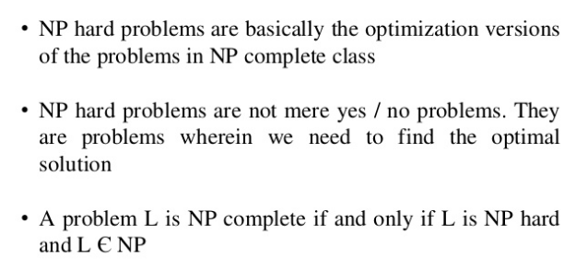
Definition: Problem B is NP–Hard if there is a Turing reduction A  B for some problem A in NP–Complete.
This implies NP–Hard problems are at least as hard as NP–Complete problems.
Thus, NP–Complete is a subset of NP–Hard.

Slide 32
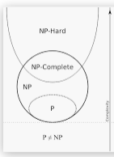
Relationship between P, NP, NPC and NP HARD Problems
Examples for NP Complete problems as:
3-SAT
3DM
Vertex Cover,
Independent Set,
Knapsack,
Multiprocessor Scheduling, and
Partition.
Special Example for NP Hard problems:
Halting Problem(Undecidable)

